Slide 1
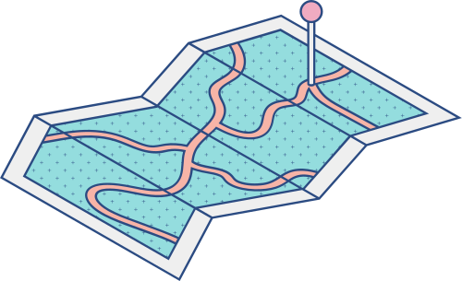





CHALLENGE 0
What’s your
current version?

Slide 2
TOPICS
TOPIC
TOPIC
TOPIC
TOPIC
1
2
3
4
Topdown
approach
Learning
How to learn
& learn fast
Autonomy
at work
Smart
question

Slide 3
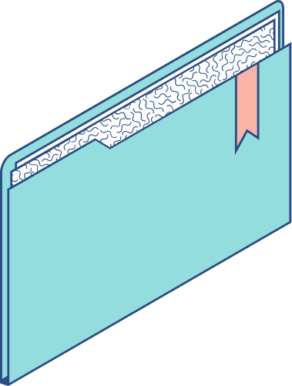
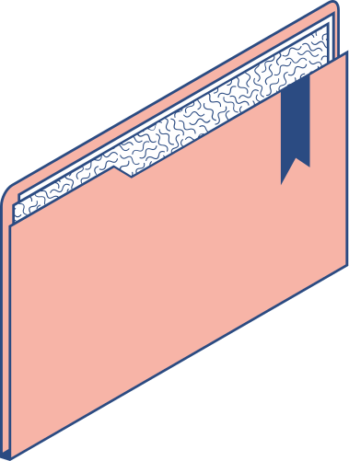

Topdown
approach

Slide 4
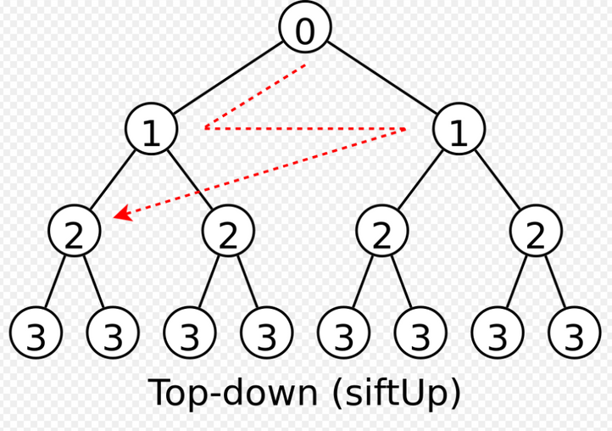
What is top-down approach?
Why use a top-down approach?
Who should use the top-down approach?
When is the right time to apply the top-down approach?
How to implement the top-down approach effectively?

Slide 5
Learning
How to learn
& learn fast

Slide 6
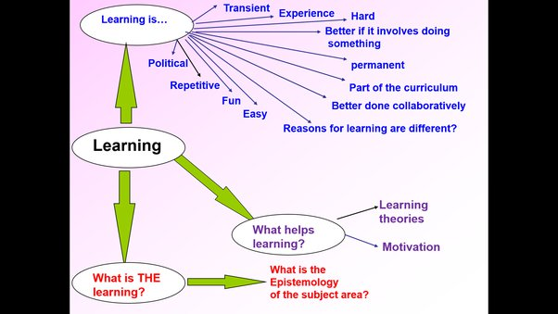
What is Learning?
Why is the learning
process important?
How to learn
& learn fast

Slide 7
Autonomy
At Work

Slide 8

What is Autonomy At Work?
Benefits of Autonomy At Work
How to build trust and encourage autonomy at work?
An example of autonomy at work!

Slide 9
Smart question

Slide 10

What's the Smart question?
Why is it important to ask smart questions?
How to apply it on
your daily work?
The benefits of smart questions

Slide 11

Thank you
for watching

